Slide 1
ATAI
Advanced Technique of Artificial Intelligence
ATAI
ChongqingUniversity _{AdvancedTechniqueof}
of Technology Artificial Intelligence
Chongqing University of
Technology
Chongqing University ^{ATAI}
_{of Technology} Advanced Techniqueof
Artificial Intelligence
Chongqing University of Technology
Chongqing University of Technology
Complexity Experts are Task-Discriminative Learners for Any Image Restoration
Code : https://github.com/eduardzamfir/MoCE-IR
—— cvpr’2025
2025.3.24. • ChongQing
Reported by YaoYao Zhang
1

Slide 2
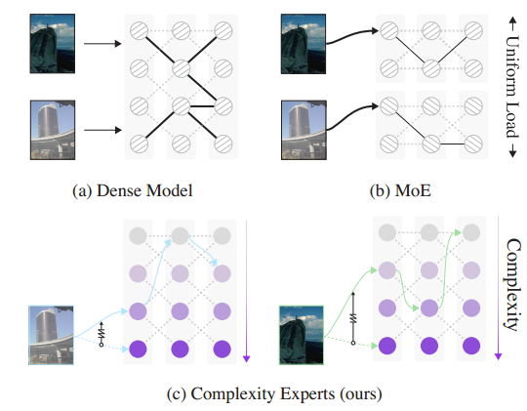
ATAI
Advanced Technique of Artificial Intelligence
ATAI
ChongqingUniversity _{AdvancedTechniqueof}
of Technology Artificial Intelligence
Chongqing University of
Technology
Chongqing University ^{ATAI}
_{of Technology} Advanced Techniqueof
Artificial Intelligence
Chongqing University of Technology
Chongqing University of Technology
Motivation
1) Dense all-in-one restoration methods often inefficiently allocate parameters when handling multiple degradation types.
2) Mixture-of-Experts (MoE) approaches address this through sparse computation, their rigid routing mechanisms uniformly distribute inputs across experts without considering the natural relationships between degradations.

Slide 3
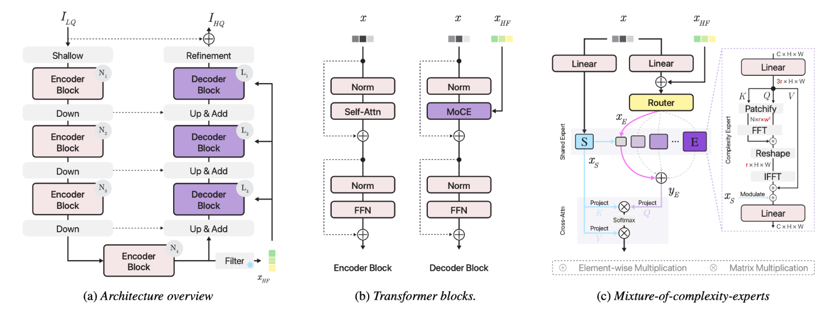
ATAI
Advanced Technique of Artificial Intelligence
ATAI
ChongqingUniversity _{AdvancedTechniqueof}
of Technology Artificial Intelligence
Chongqing University of
Technology
Chongqing University ^{ATAI}
_{of Technology} Advanced Techniqueof
Artificial Intelligence
Chongqing University of Technology
Chongqing University of Technology

Slide 4
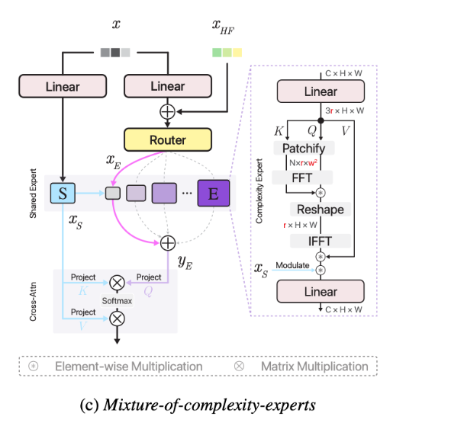
ATAI
Advanced Technique of Artificial Intelligence
ATAI
ChongqingUniversity _{AdvancedTechniqueof}
of Technology Artificial Intelligence
Chongqing University of
Technology
Chongqing University ^{ATAI}
_{of Technology} Advanced Techniqueof
Artificial Intelligence
Chongqing University of Technology
Chongqing University of Technology
Method

Slide 5
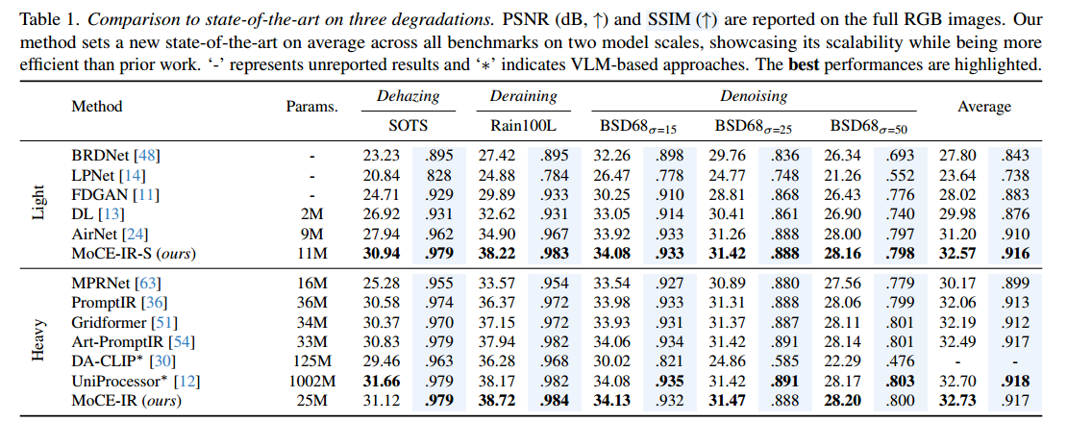
ATAI
Advanced Technique of Artificial Intelligence
ATAI
ChongqingUniversity _{AdvancedTechniqueof}
of Technology Artificial Intelligence
Chongqing University of
Technology
Chongqing University ^{ATAI}
_{of Technology} Advanced Techniqueof
Artificial Intelligence
Chongqing University of Technology
Experiments
Chongqing University of Technology

Slide 6
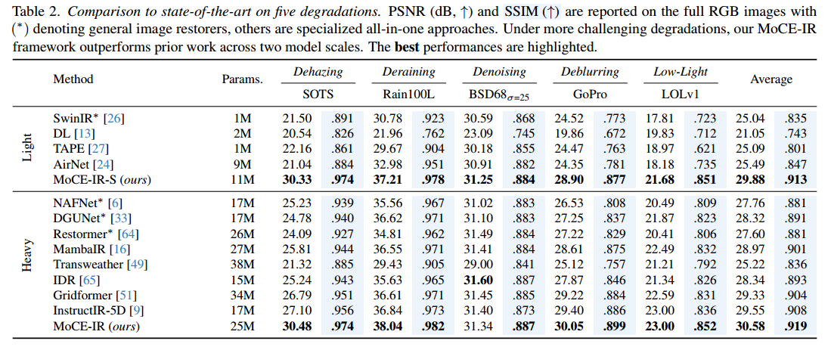
ATAI
Advanced Technique of Artificial Intelligence
ATAI
ChongqingUniversity _{AdvancedTechniqueof}
of Technology Artificial Intelligence
Chongqing University of
Technology
Chongqing University ^{ATAI}
_{of Technology} Advanced Techniqueof
Artificial Intelligence
Chongqing University of Technology
Chongqing University of Technology

Slide 7
ATAI
Advanced Technique of Artificial Intelligence
ATAI
ChongqingUniversity _{AdvancedTechniqueof}
of Technology Artificial Intelligence
Chongqing University of
Technology
Chongqing University ^{ATAI}
_{of Technology} Advanced Techniqueof
Artificial Intelligence
Chongqing University of Technology
Chongqing University of Technology

Slide 8
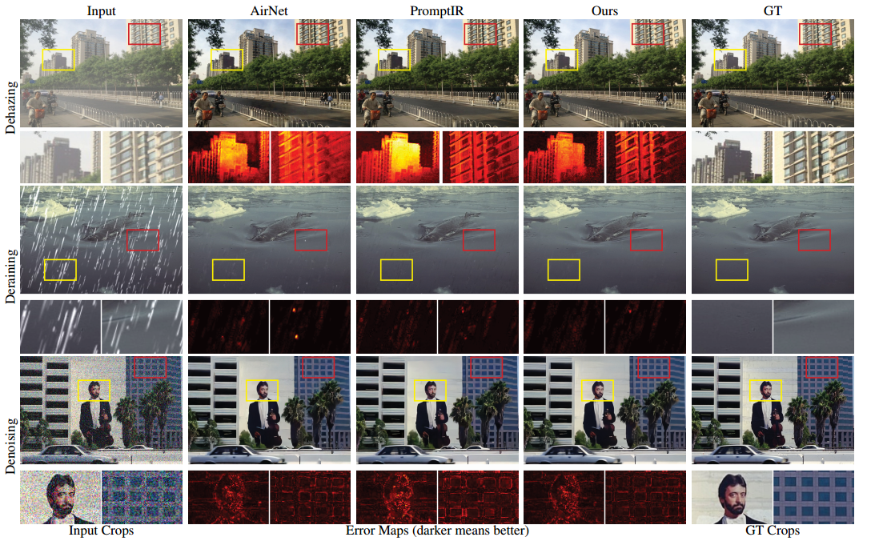
ATAI
Advanced Technique of Artificial Intelligence
ATAI
ChongqingUniversity _{AdvancedTechniqueof}
of Technology Artificial Intelligence
Chongqing University of
Technology
Chongqing University ^{ATAI}
_{of Technology} Advanced Techniqueof
Artificial Intelligence
Chongqing University of Technology
Chongqing University of Technology

Slide 9
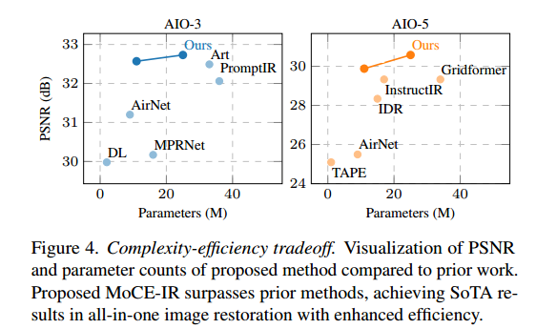
ATAI
Advanced Technique of Artificial Intelligence
ATAI
ChongqingUniversity _{AdvancedTechniqueof}
of Technology Artificial Intelligence
Chongqing University of
Technology
Chongqing University ^{ATAI}
_{of Technology} Advanced Techniqueof
Artificial Intelligence
Chongqing University of Technology
Chongqing University of Technology

Slide 10
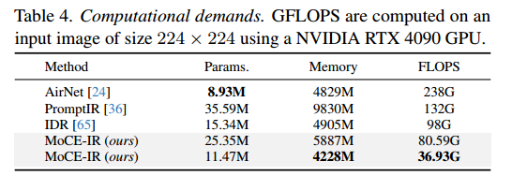
ATAI
Advanced Technique of Artificial Intelligence
ATAI
ChongqingUniversity _{AdvancedTechniqueof}
of Technology Artificial Intelligence
Chongqing University of
Technology
Chongqing University ^{ATAI}
_{of Technology} Advanced Techniqueof
Artificial Intelligence
Chongqing University of Technology
Chongqing University of Technology

Slide 11
ATAI
Advanced Technique of Artificial Intelligence
ATAI
ChongqingUniversity _{AdvancedTechniqueof}
of Technology Artificial Intelligence
Chongqing University of
Technology
Chongqing University ^{ATAI}
_{of Technology} Advanced Techniqueof
Artificial Intelligence
Chongqing University of Technology
Chongqing University of Technology

